Slide 1
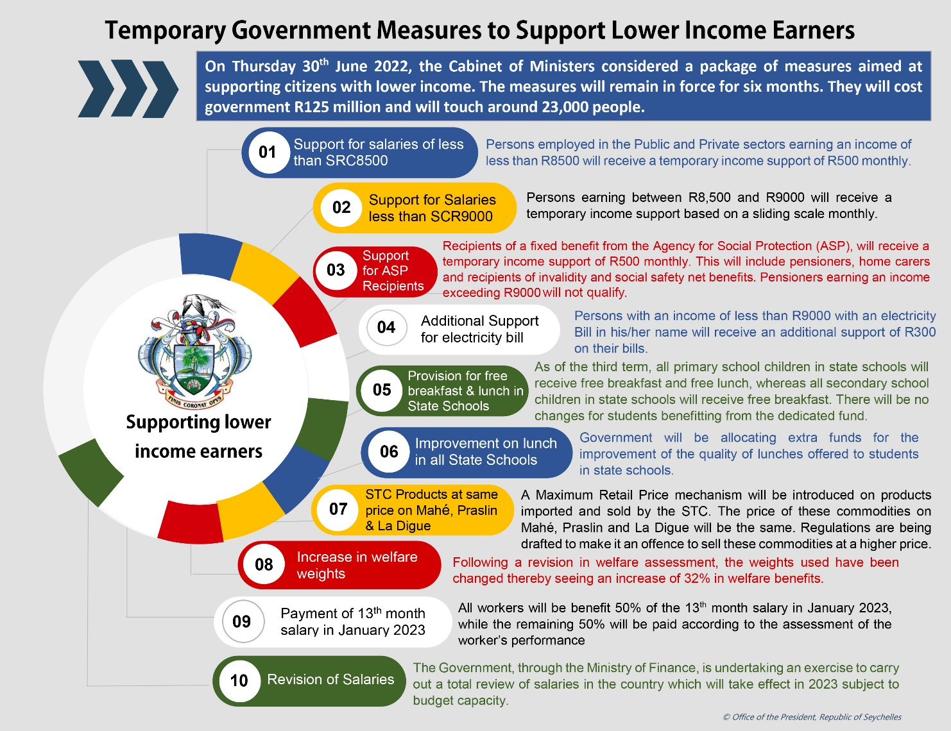
Temporary Government Measures to support the lower income earners

Slide 2
Measures
Financial Support for those whose income does not exceed R8’500
Financial Support for those, whose income is between R8’500 and R9’000.
Additional Support for electricity Bill

Slide 3
Preliminary Measures under the programme
Objective: Ease the financial pressure on lower income earners
Duration:
The measures are temporary, (6 months), and collection of data will be less than 3 months
Payment
First payment for private sector employees and additional support for payment of electricity bill, will be in August (Backpay for July)
Impact
Support for those whose income does not exceed R8’500 (13,000 employees) – R40 million
Support for those, whose income is between R8’500 and R9’000 (2,500 employees) – R3.8 million
Additional support for payment of electricity bill for those earning less than R9’000 (7’000 households) – R14.3 million

Slide 4
Measures for those whose salary do not exceed R8’500
Target:
Registration for private sector employees who are in formal employment will start on 25th July, in the District Administration’s Office
First payment - July for employees in the public sector and parastatals and August for employees in the private sector
Criteria to qualify
A salary equal and less to R8’500
Formal employment (“self-employed” does not qualify under this programme)
Contributing to the Seychelles Pension Fund
Have a Bank Account
June 2022, payslip
Private Sector employees
Information will have to be collected
Public Sector Employees and Parastatals
Information to be submitted to the Ministry of Finance, National Planning and Trade

Slide 5
Measure – Support for those who income is between R8’500 and R9’000
Registration for private sector employees who are in formal employment will start on 25th July, in the District Administration’s Office
First payment - July for employees in the public sector and parastatals and August for employees in the private sector
Criteria to qualify
A salary equal and less to R9’000
Formal employment (“self-employed” does not qualify under this programme)
Contributing to the Seychelles Pension Fund
Have a Bank Account
July/June 2022, Payslip
Private Sector employees
Information will have to be collected
Public Sector Employees and Parastatals
Information to be submitted to the Ministry of Finance, National Planning and Trade

Slide 6
Measure – Additional Support for payment of Electricity Bill
Target: Collection of information will start as of 25th July, 2022
First Payment: August
Criteria to qualify
A monthly income not exceeding R9’000
Formal Employment (self-employed does not qualify under this programme)
Contributing towards the Seychelles Pension Fund
Have a Bank Account
Payslip dated June, 2022
If Bill is in your name | If Bill is not in your name
Qualify | Bill is in the name of other person | Renting
Electricity Bill, dated not earlier than June, 2022 | Kindly, contact PUC to rectify and have bill transfer to your name | -Copy of a valid rental contract and Landlord have to sign the bill, which should be dated not earlier than June, 2022

Slide 7
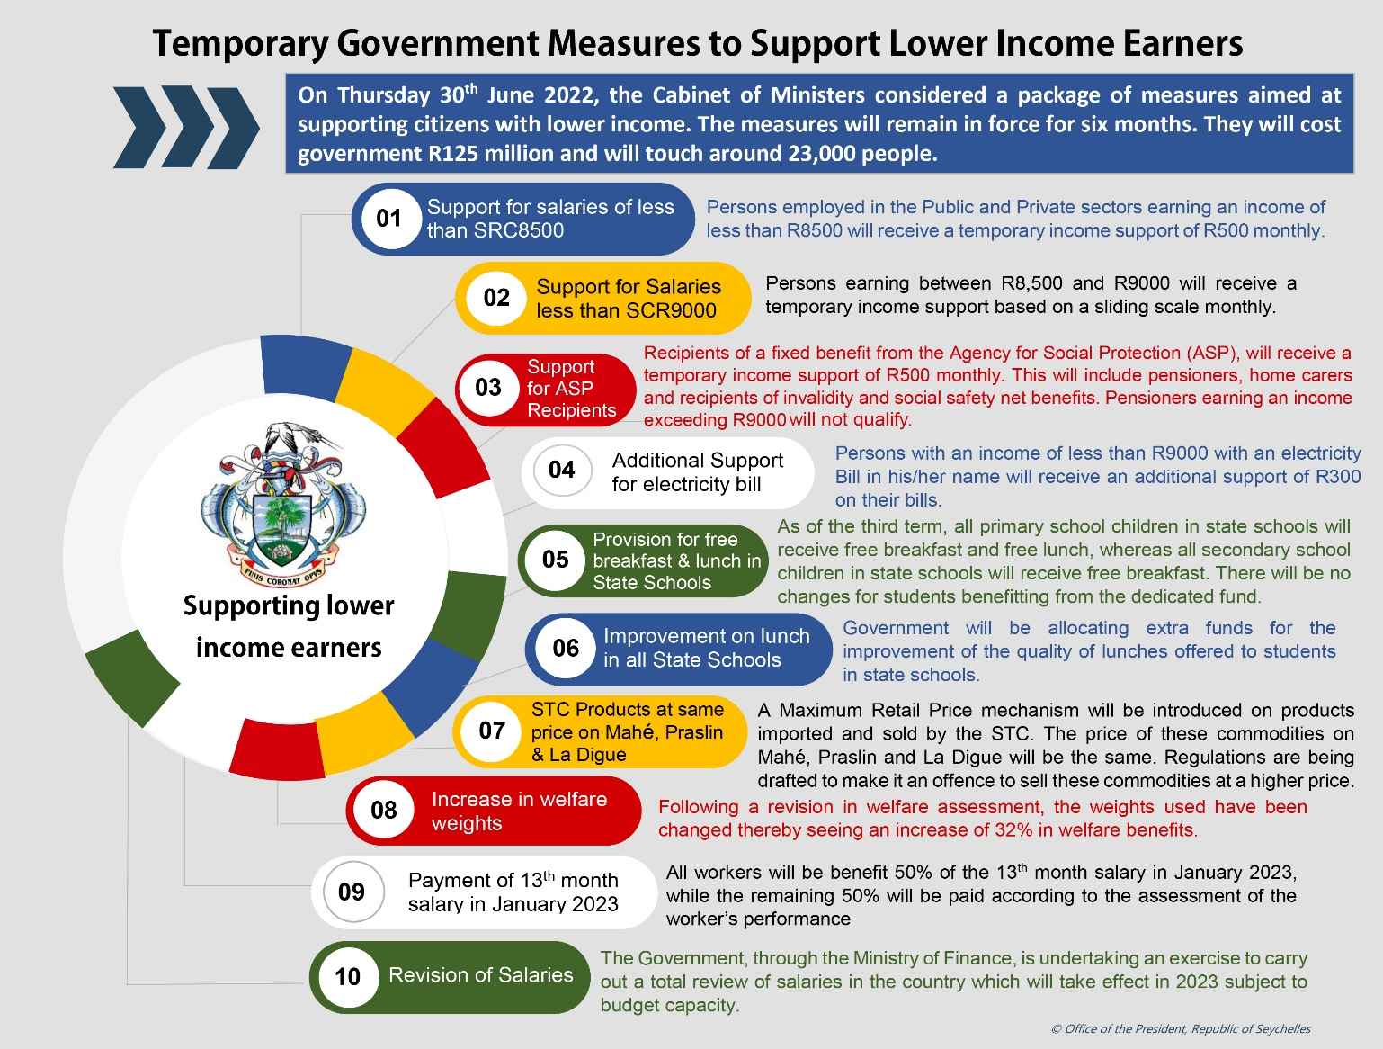
Other Measures
Support for those on welfare/pensioners and home care
Free breakfast and lunch (primary students) and free breakfast for secondary students in state schools
Improvement of quality of school lunch
Introduction of a Maximum Retail Price Mechanism on sale of goods imported by STC
32% increase in welfare weights
Payment of 13th month salary (50% guaranteed, 50% based on performance
Salary Revision
Details will be announced later

Slide 8
Your Role
Between now and the 25th July, collect the required documents, in order to facilitate the registration process and ensure you benefit under the programme.
Temporary income Support
June, July 2022 Payslip,
Confirm you are contributing to the Pension Fund
Your bank card with all your details
Valid National Identity Card
Additional support for electricity
June/July electricity bill
Valid National Identity Card
Your bank card with all your details
June/July 2022 Payslip
Confirm you are contributing to the Pension Fund
If Bill is in your name | If Bill is not in your name
Qualify | Bill is in the name of other person | Renting
Electricity Bill, dated not earlier than June, 2022 | Kindly, contact PUC to rectify and have bill transfer to your name | -Copy of a valid rental contract and Landlord have to sign the bill, which should be dated not earlier than June, 2022

Slide 9
Important Notice
All private sector employees who are in formal employment, who qualify under the programme, are being asked to use the time between now and the registration date, to ensure all their documents are in order, to thus facilitate the registration process, which will start on 25th July, 2022.
It is important information being given to receive support under this programme is correct at the time of registration.
If there is a change in your employment status during the time you are benefiting under this programme, it is your responsibility to submit a new application, especially if your new income, will have an impact on the level of support you are receiving.
Further information will be given by the Ministry of Finance, National Planning and Trade on 15th July, 2022.

